Slide 1
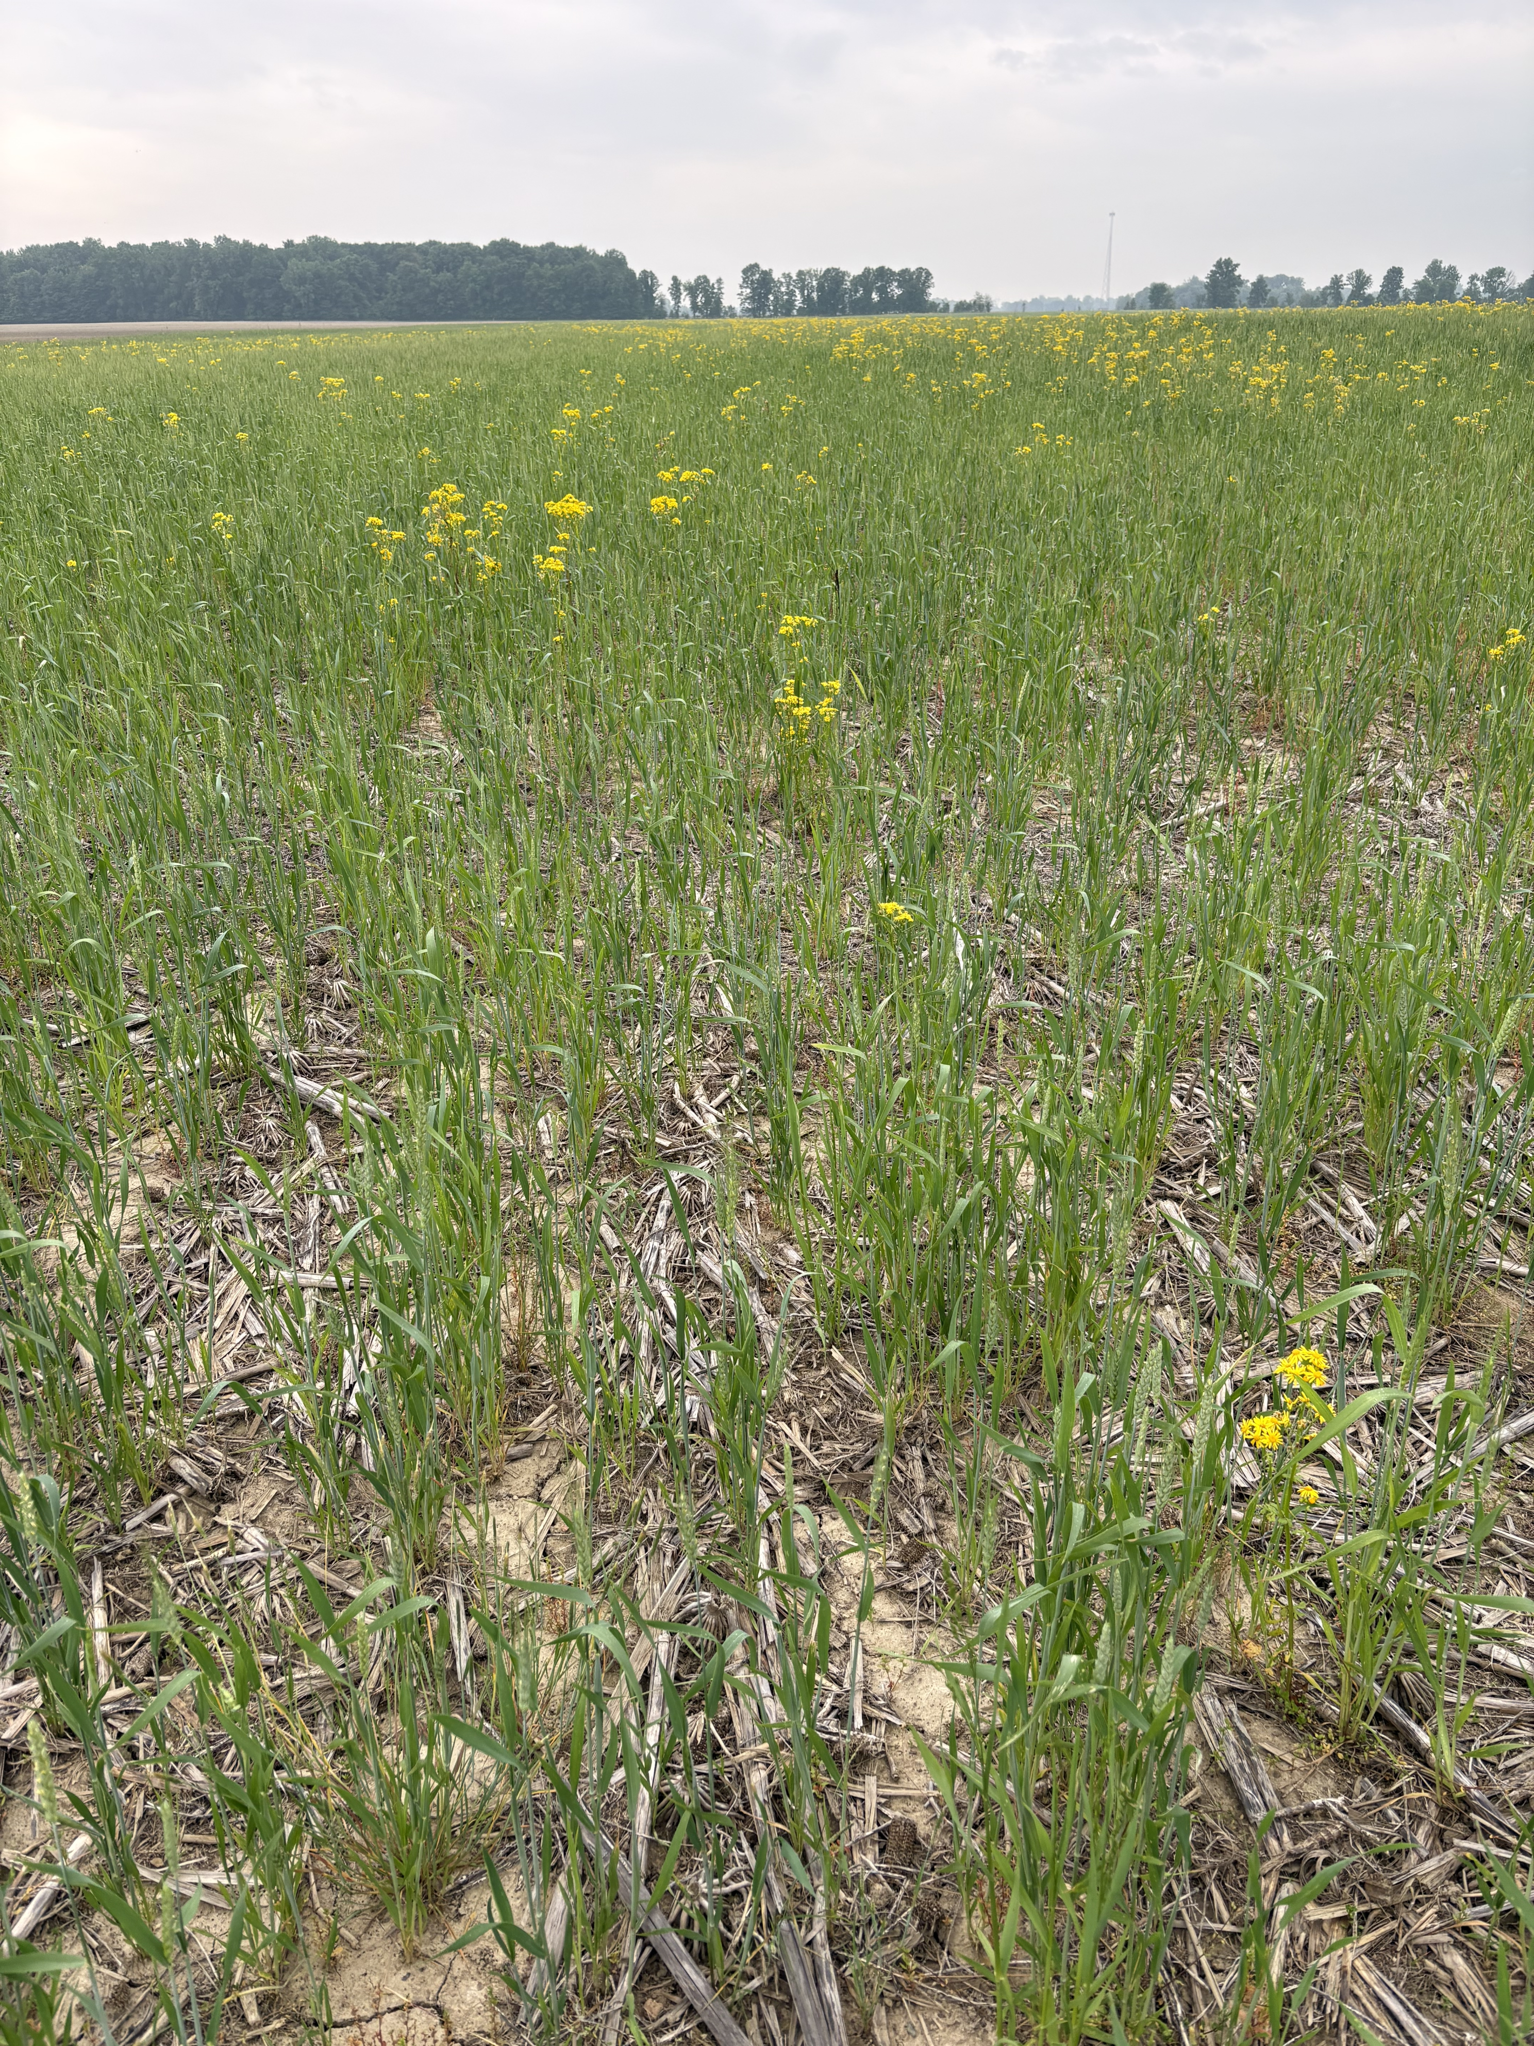
KS65 Sunflower Sky
Update Needed
Picture with Grass
Project Kickoff
November 13, 2025

Slide 2
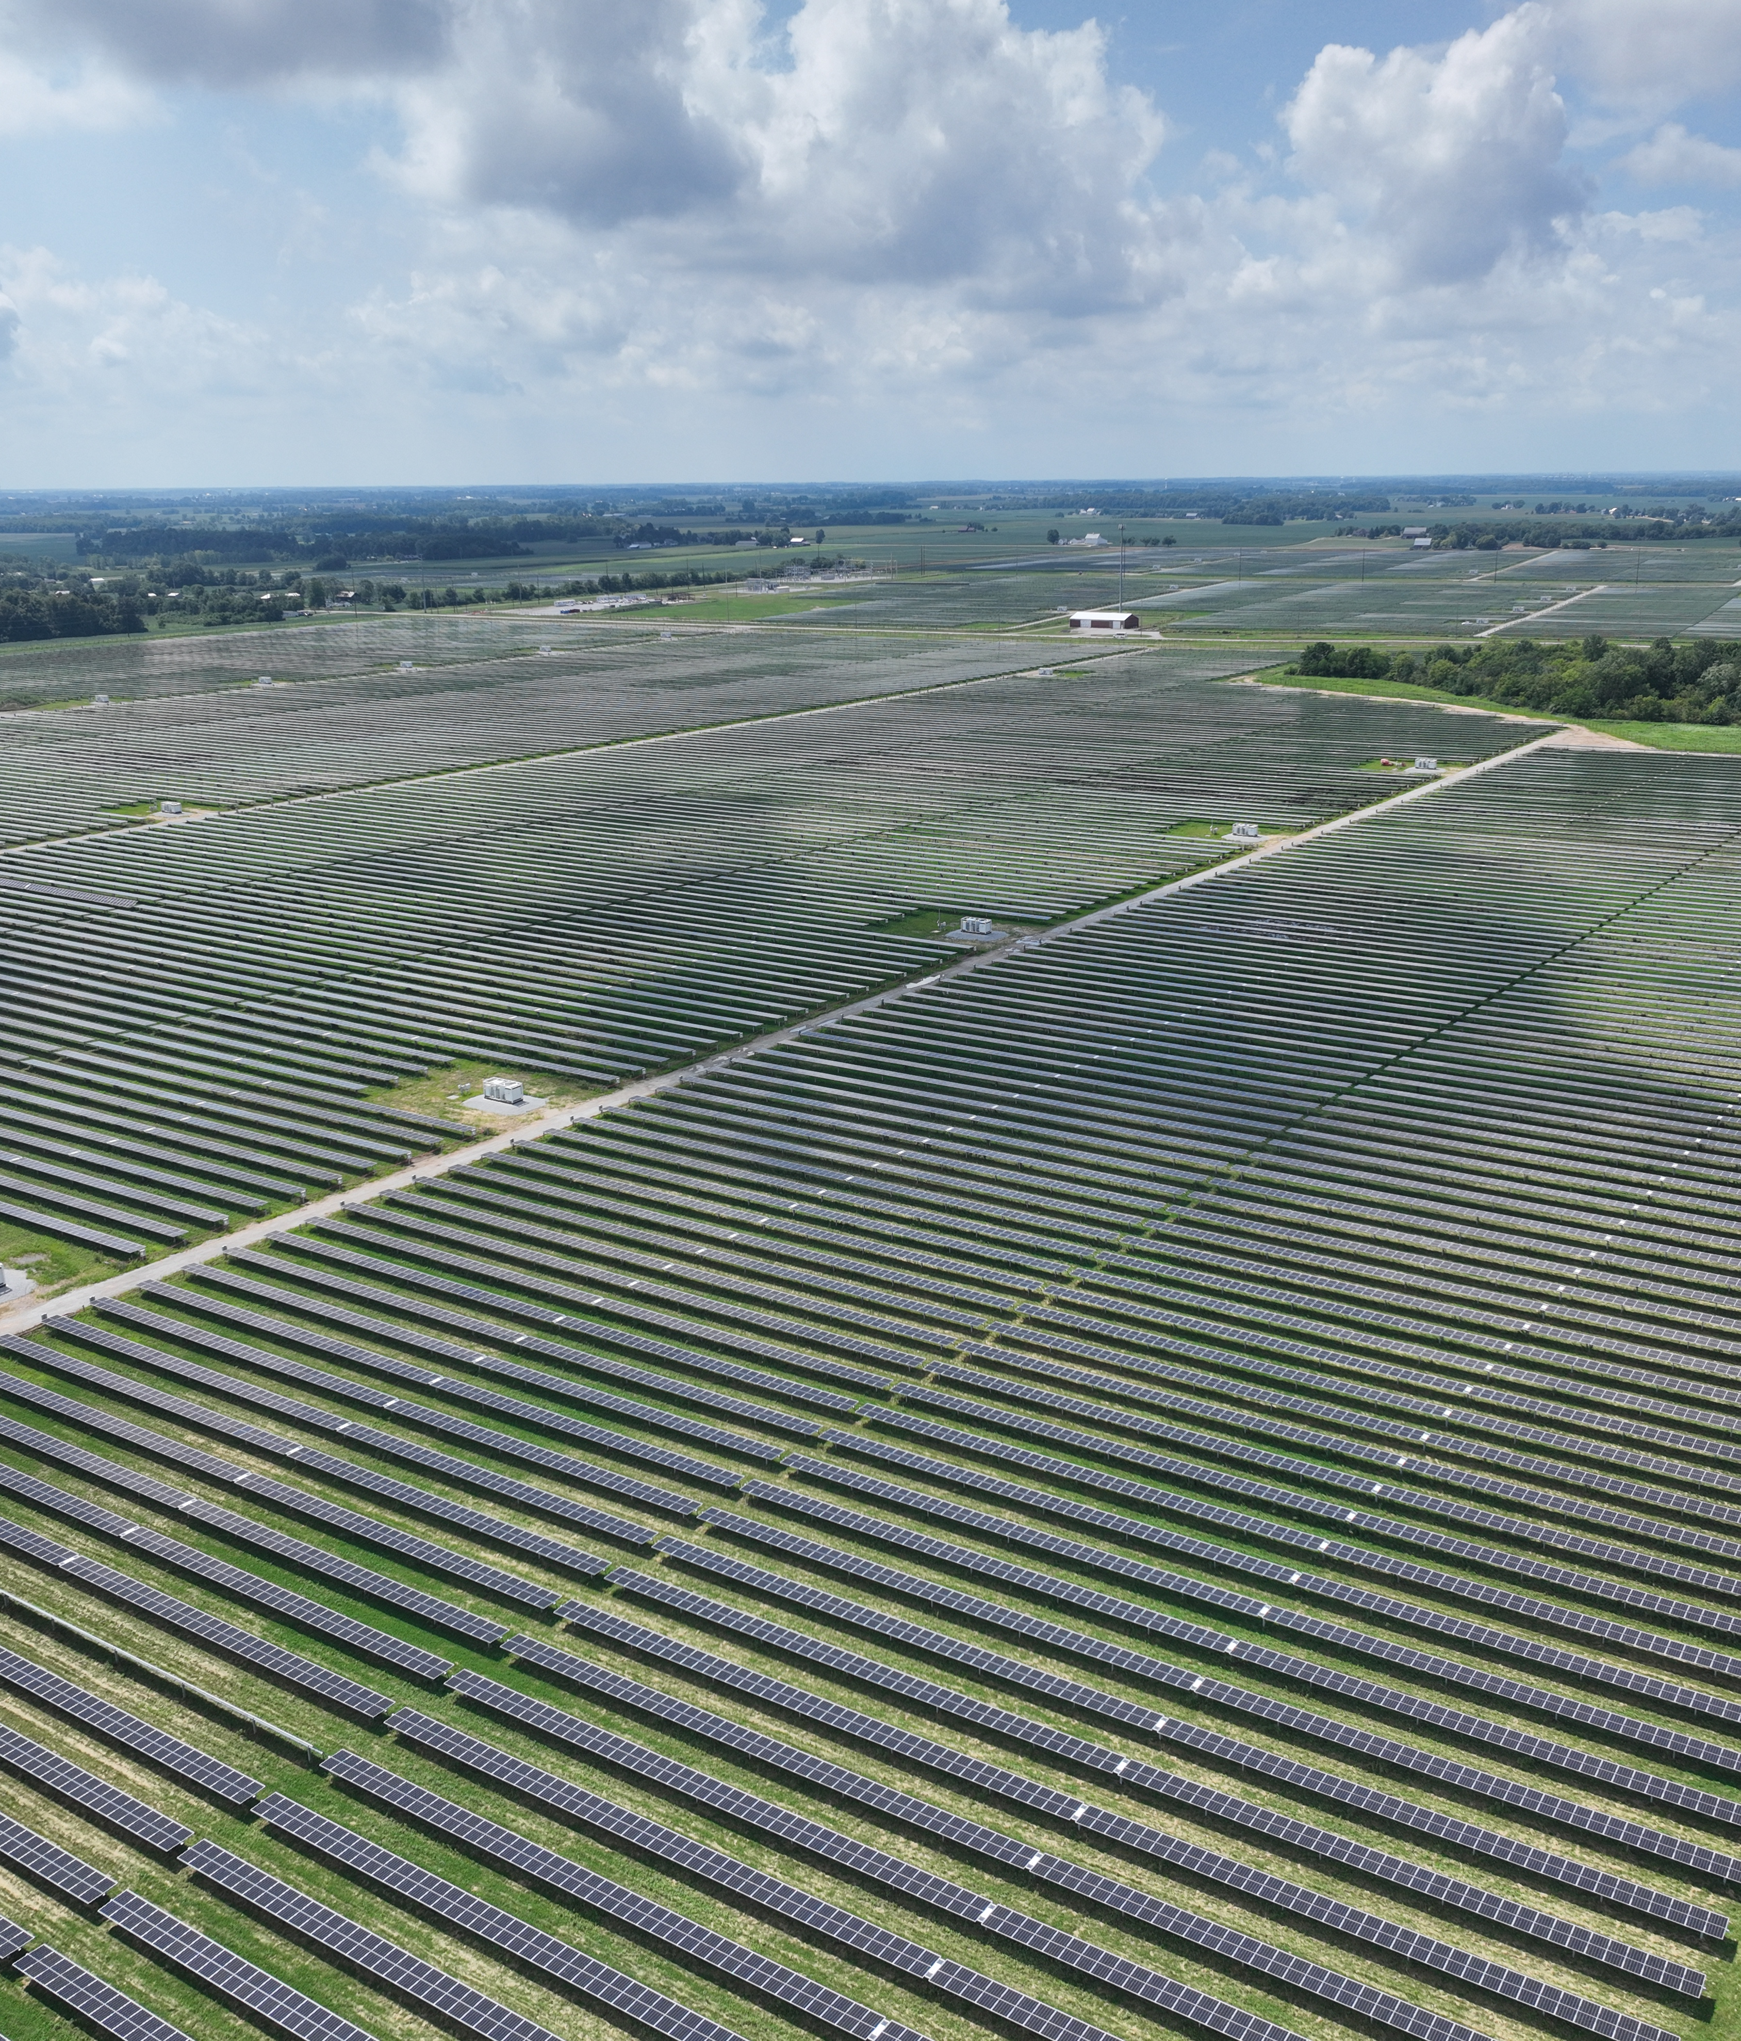
Agenda
Project Closeout
Safety
Key DEPCOM Stakeholders
Principle Based Management (PBM) Overview
Stewardship
Project Intro
Schedule Milestones
Procurement Schedule
Project Risks & Opportunities
Engineering Status
Subcontractors
Team Goals
Procore / Communications
Quality Management
Logistics Management
Construction Management Review
High Voltage
Environmental Compliance
Commissioning Overview
©2025 DEPCOM Power. All Rights Reserved.

Slide 3
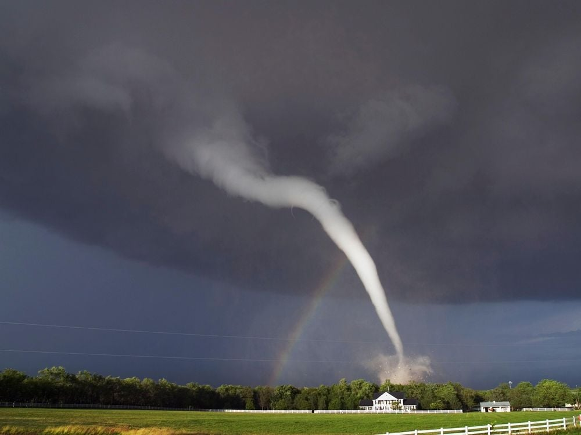
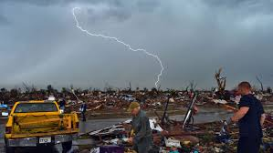
Safety Moment
Tornado Safety
Definition: A tornado is a rapidly rotating column of air that extends from a thunderstorm to the ground. It appears as a funnel-shaped cloud, often containing debris and dust.
Formation: Tornadoes typically form from severe thunderstorms when warm, moist air meets cold, dry air. They can occur anywhere in the world but are most common in the central United States.
Destruction: Tornadoes can cause extreme damage to buildings, vehicles, and infrastructure. They can have wind speeds ranging from less than 100 mph to over 300 mph.
Safety Measures: It's crucial to have a plan in place for tornado emergencies. Monitor weather forecasts and warnings. Seek shelter in a sturdy building, preferably a basement or interior room on the lowest floor. Avoid windows and protect yourself from flying debris.
Notes:
Tornado signs: Dark Green sky, wall cloud, hail bigger than an inch. It’s time to leave even before warning.

Slide 4

Safety Moment
Tornado Safety Cont.
Before a Tornado: Create a family emergency plan and practice tornado drills. Identify a safe room in your home or shelter nearby. Secure outdoor items and reinforce windows if possible.
During a Tornado: Take shelter immediately in a basement or interior room without windows. Cover your head and neck with your arms or a sturdy object. Listen to a battery-powered weather radio or smartphone for updates.
After a Tornado: Check for injuries and administer first aid if necessary. Be cautious of hazards such as downed power lines and gas leaks. Contact emergency services if needed and assist neighbors if safe to do so.
Conclusion: Tornadoes are powerful natural phenomena that require preparation and quick action to stay safe.
Notes:
There are no community shelters in Douglas county. The closest community tornado shelter I could find, the Lawerence community center is 2 hours away. What options does that leave us with? Trailers are a no go. Why? They often lack anchoring capable of resisting tornado-level winds. Trailers may not offer enough protection from penetration by flying objects. The trailer is your work station not your tornado shelter. So what do we do? Watch means ready, Warning means shelter. In a tornado watch, alert, monitor and inform. Inform your team where a safe location for shelter is. For a tornado warning we will STOP WORK IMMEDIATELY, gather headcount and accountability, seek shelter. I know some people are leaving the work trailer and going to a home trailer so I’ve taken the time to find some buildings that are possible shelters in the vicinity. Once I have confirmation I will add them to the severe weather plan. USACE Clinton Lake Project Office; Clinton State Park Office; Morning Star Church;

Slide 5
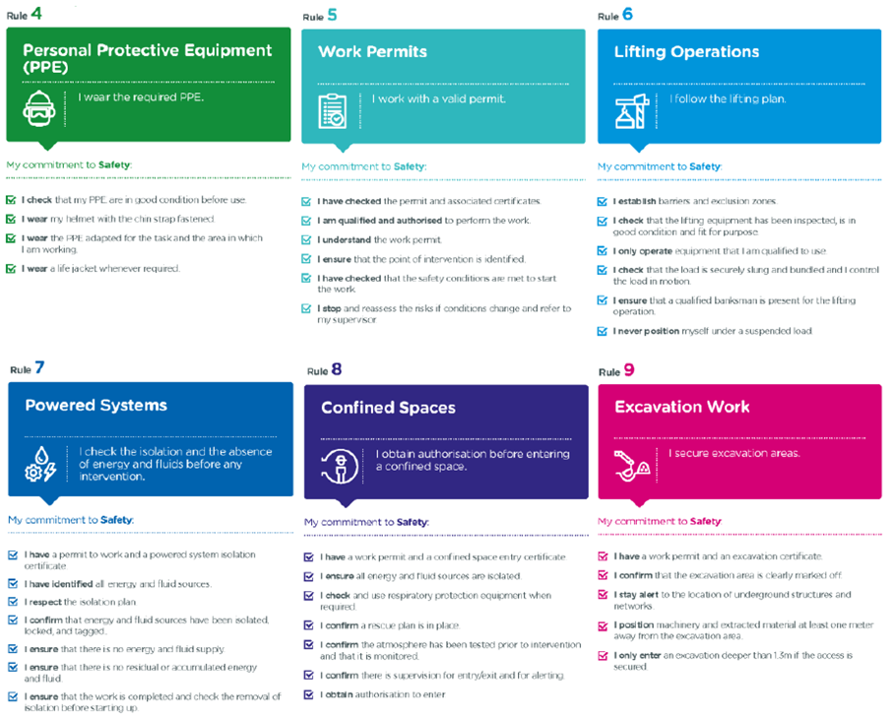
Safety, Health & Environment
12 Golden Rules
HSE Induction – Site Specific Orientation
DEPCOM Safety Vision
The Safety and well-being of our employees and communities is our first priority, Always. We build capability in our people and resilience in our systems to adapt, prevent, contain and recover so that when the unexpected happens, no one is killed or seriously hurt.
Shared Vision
This vision is reinforced in orientation materials, safety briefs, and leadership meetings, and it calls for effective and proactive safety leadership, shared responsibility, and empowerment of every employee to act as a safety leader.
Notes:
Just like OSHA has the focus four, we have 3 times that in sections we focus on leading us to the 12 golden rules. High Risk situations being the first rule listed, that’s also how we like to start our days at DEPCOM, addressing the highest risks we have planned for that day, whether it be carrying loads under power lines when just starting out, or a critical lift above 75% of the cranes capacity that needs a 3D drawing. We start our days focused on how to mitigate the most significant risks first. 2 is traffic, 3 is body mechanics. 10 is work at height, 11 is hot work and 12 is line of fire(simops). Most of our construction sites have a bilingual workforce and all of our worksites have signs and documentation in both English and Spanish. All Our all hands meetings are bilingual, with translators a part of all work crews where needed. We are looking forward to building a safety culture together, and I’ll briefly touch on some initiatives we’ll lean on to make it a strong safety culture.

Slide 6
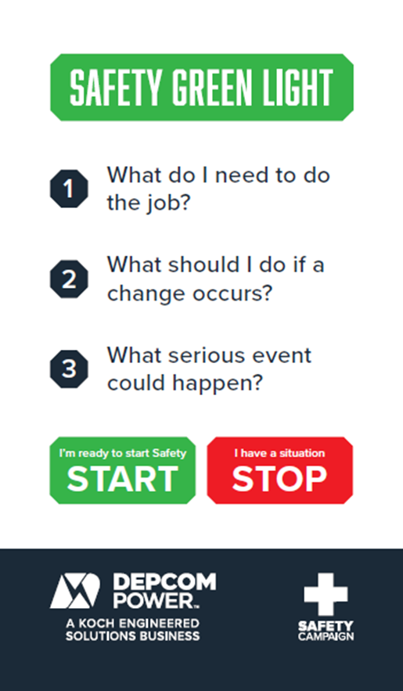
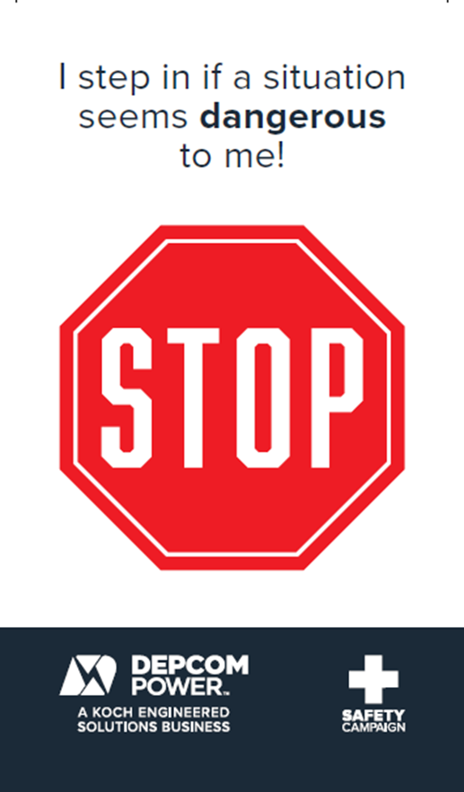
Safety
Safety Green Light Initiative – Stop Work Card
Green Light Initiative
Three open questions to be embedded into pre-job discussions
Stop Work Policy
Positive Reinforcement
No Disciplinary Action
Site-Level Commitment: This policy shall be documented and VISIBLY posted at the site.
Leadership Endorsement: Policy will be signed by senior management to reinforce accountability and support.
Notes:
At DEPCOM there’s no difference if you are the CEO or they contracted you to come sweep the stairs on Tuesday. Everybody on site is empowered with Stop Work Authority. Adopting the stop work card from Total, we’ve implemented this as a best practice across all of our sites. We don’t enforce a fear-based culture at DEPCOM and encourage everyone to speak up. Utilize this card and work will only resume after the issue is resolved and consensus is reached.
Positive Reinforcement: Actively recognize and celebrate individuals who exercise Stop Work Authority to prevent unsafe conditions.
No Disciplinary Action: Guarantee that no disciplinary sanctions will follow when work is stopped for safety concerns.

Slide 7


Safety
Positive Reinforcement
Celebrate Safety Champions
  Site-level recognition programs honor key contributors to safety culture
  Perks include preferred parking, site giveaways, and food trucks during Safety Week
Safety Coins Program
  Level 1 (Orange) coin required to qualify for Level 2
  Awarded for:
    Leading safety within their crew
    Holding coworkers accountable
    Identifying and mitigating risks (“good catches”)
Notes:
At DEPCOM we believe in recognizing and incentivizing strong safety practices. We have implemented safety champion programs honoring key contributors to the safety culture on each site, giving them preferred parking and other perks. We've had site giveaways for safety knowledge and have had food trucks catering to highlight safety week. Exceptional safety performance is rewarded in numerous ways, including Safety coins. These are the set of coins we are on currently. You must obtain a level 1 coin (orange) to be eligible for a level 2 coin. We've handed them out for being a safety leader in their group and holding their coworkers accountable. We've handed them out for good catches that mitigated a risk, protecting their fellow coworker. On the flip side of that coin no pun intended or maybe it was, there are consequences for bad safety practices, yet we don't implement a fear based culture. We lead with verbal coaching and retraining; • Low-risk behavior: Coaching and education. • High-risk or repeat behavior: Escalated disciplinary action, up to removal from site. All actions are documented and reviewed by the HSE committee to ensure consistency and fairness.

Slide 8
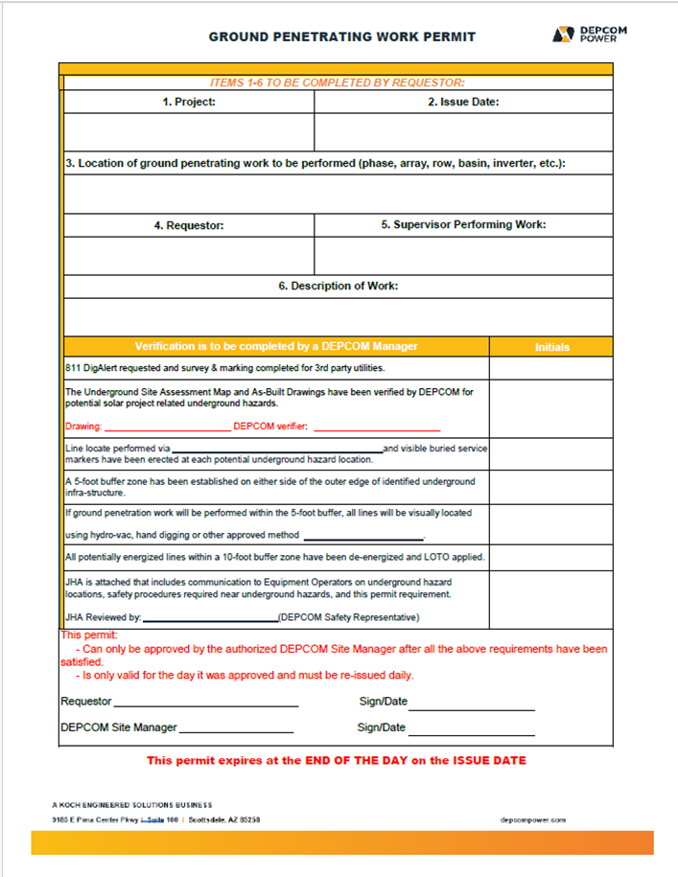
Safety
DEPCOM Power + Permit To Work
Permits Expire Daily
Site conditions change during the course of the day, and especially overnight.
Permit + Accompanying Documents
JHA's, Drawings, Method Statements
Accessible Information
The information packet shall be available upon request at location of the work
Notes:
At DEPCOM we believe in recognizing and incentivizing strong safety practices. We have implemented safety champion programs honoring key contributors to the safety culture on each site, giving them preferred parking and other perks. We've had site giveaways for safety knowledge and have had food trucks catering to highlight safety week. Exceptional safety performance is rewarded in numerous ways, including Safety coins. These are the set of coins we are on currently. You must obtain a level 1 coin (orange) to be eligible for a level 2 coin. We've handed them out for being a safety leader in their group and holding their coworkers accountable. We've handed them out for good catches that mitigated a risk, protecting their fellow coworker. On the flip side of that coin no pun intended or maybe it was, there are consequences for bad safety practices, yet we don't implement a fear based culture. We lead with verbal coaching and retraining; • Low-risk behavior: Coaching and education. • High-risk or repeat behavior: Escalated disciplinary action, up to removal from site. All actions are documented and reviewed by the HSE committee to ensure consistency and fairness.

Slide 9
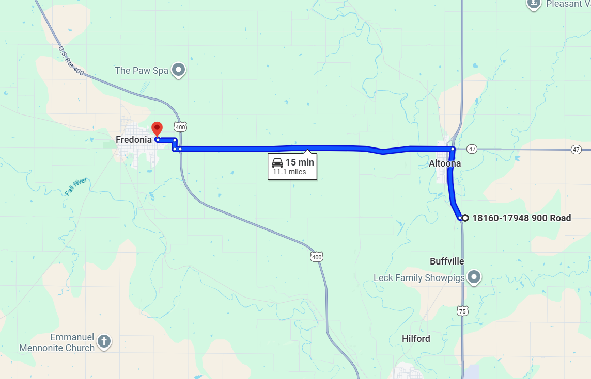
Safety
Emergency Action Plan
Dynamic Muster Points
  Muster areas may change as construction phases begin and end
  EAP is continuously updated to reflect current site layout
Comprehensive Response Planning
  Covers scenarios from weather events to motor vehicle accidents
  Includes details on surrounding area and access routes
Commitment to Safety Culture
  Emergency drills are planned to reinforce preparedness
  Building a strong safety culture together every voice matters
Notes:
As construction phases begin and end, muster points sometimes change. We are committed to keeping the EAP updated with information on the muster areas, the surrounding area, giving response plans on everything from weather events to motor vehicle accidents. Looking forward to the emergency drills and looking forward to building a strong safety culture with all of you. I’ll open the floor for questions now, if there are none we can move to the next slide.

Slide 10
Key Stakeholders - DEPCOM
Name | Role/Title
Byron Lamon | Sr. Vice President, Project Delivery
Chris White | Vice President, Project Delivery
Nathan McAdams | Business Development Director
Daniel Bolden | Director, Project Delivery
Andy Keleske | Project Manager
Shelton Hipsher | Construction Manager
Joshua Wood | Assistant Construction Manager
Mason Miller | Project Engineer
Joe Siwa | Field Engineer
Will Lewis | Substation Project Manager
Chris Frye | Quality Manager
Notes:
Project Centric Mindset
Value Creation through Empowerment & Engagement
At DEPCOM, enabling profitable projects and services that
create long-term value for our customers is fundamental to
how we work.
Being Project Centric means focusing on the success of the
entire project, not just your individual role. It’s about working
as one team, taking ownership, and proactively solving
problems to keep projects on track.
Success depends on our ability to estimate, execute, and
deliver with discipline, using our talents and capabilities to
create a durable advantage.
Every employee is expected to understand how their work
contributes and to help deliver reliable results and stronger
outcomes.

Slide 11
Key Stakeholders - DEPCOM
Name | Role/Title
Julian Stubblefield-Banks | Regional Safety Manager
TBD | Project Safety Manager
Tanner Snowden | Civil Superintendent
TBD | Mechanical Superintendent
Jackson Samples | Electrical Superintendent
Gary Butzlaff III | Regional Quality Manager
Bryant Bowyer​ | Director, Field Logistics​
Julio Avina | Site Logistics Manager​
Breanna Jager | Project Coordinator

Slide 12

Principle Based Management (PBM)
Empowering Long-Term Success
What is PBM?
Principle Based Management is a proven framework that helps organizations achieve long-term success by empowering individuals and focusing on value creation.
The Five Dimensions
Vision
Virtue & Talents
Knowledge
Comparative Advantage
Motivation
Benefits to the Business
Greater innovation, higher employee engagement, superior results through mutual benefit, and adaptability.
Notes:
Purpose
I found, with this being our kickoff, to start with the core of our business, PBM -
Principle Based Management is a proven framework that helps organizations achieve long-term success by empowering employees and focusing on value creation.
What is PBM? PBM is about applying time-tested principles—like mutual benefit and respect for individuals—instead of relying on rigid rules or one-size-fits-all policies.
Why it Matters: This approach enables us to innovate, adapt, and get the best from every team member, which drives superior results for the business.
What’s Different: Unlike traditional management, PBM customizes roles, responsibilities, and rewards to each person, helping everyone maximize their contribution by focusing on the 5 dimensions:
Vision: Setting clear direction and focus on long-term value.
Virtue & Talents: Building a culture of integrity and leverage each person’s strengths.
Knowledge: Encouraging learning, innovation, and sharing ideas.
Comparative Advantage: Aligning roles so everyone does what they do best.
Motivation: Inspire and reward people to maximize their contribution.
I would like to setup a separate session specifically with our teams to discuss how PBM could benefit this projects’ long-term success.

Slide 13
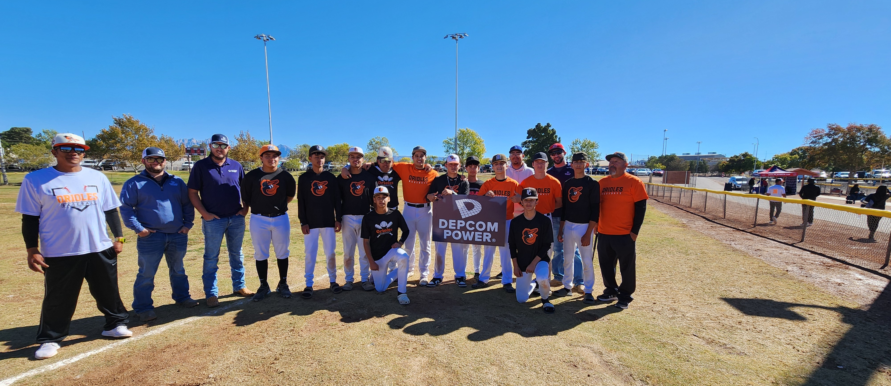
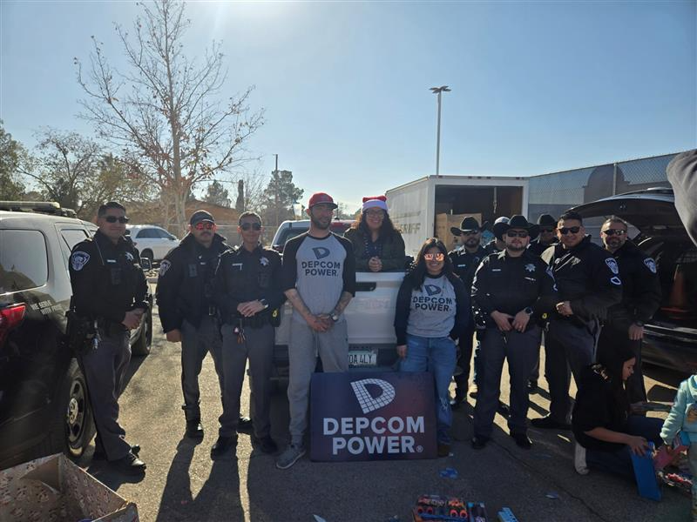

Economic/Stewardship Development Management Plan
Engaging with the local community examples:
  Schools
  Community events
  Shelters
  Parks
  Fire Department
  Utilize local vendors for site events
Stimulating job creation and workforce development:
  Local IBEW Partnership
  Utilizing local contractors (mowing, equipment rental, waste management, aggregate supply)

Slide 14
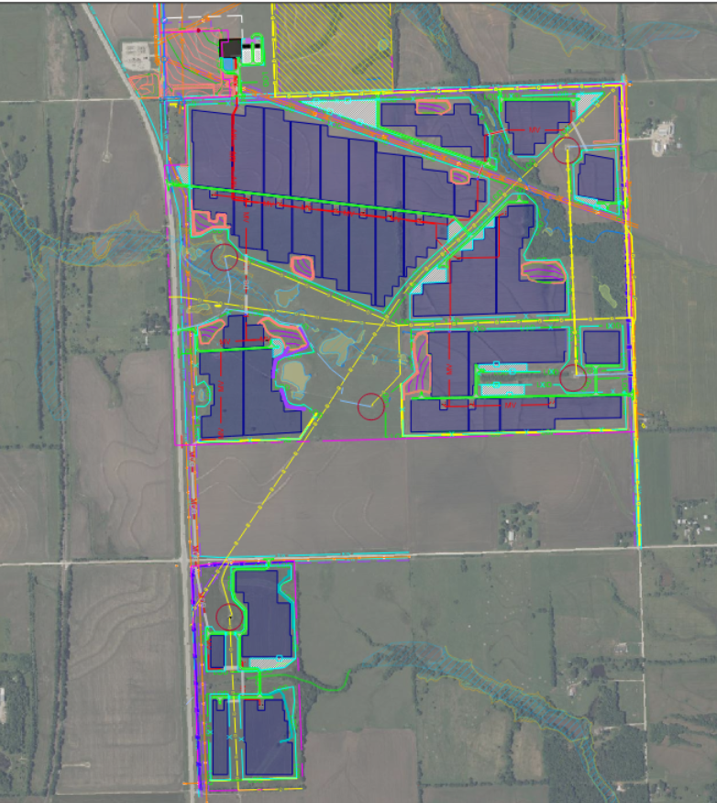
Project Introduction
PV: 65 MWac | 88 MWdc
658 Acres Total Site Area
349 Acres Total Disturbed Area
3 MV Collection Circuits
19 Arrays
20,065 LF of Access Roads
8 Sediment Basins
1 Sediment Trap
Collector Substation
O&M Building
Notes:
DEPCOM Observed Holidays 2025
Labor Day: September 1
Thanksgiving: Thursday, November 27
Day After Thanksgiving; Friday, November 28
Day Before Christmas: Wednesday, December 24
Christmas Day: Thursday, December 25
2026 New Year’s Day: Thursday, January 1

Slide 15
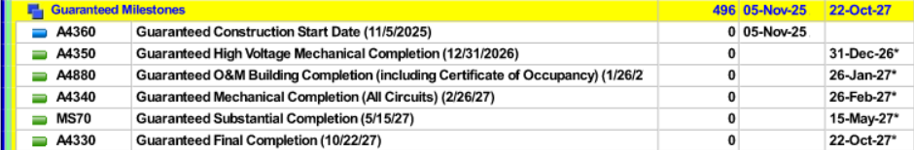
Schedule Milestones

Slide 16
Procurement Schedule
Procurement​ | PO Status | Supplier | Responsible Party​ | Delivery Start​
Inverters​ | Issued | Sungrow | DEPCOM​ | 7/10/26
Posts​ | 11/15/25 | Powerhouse | DEPCOM​ | 2/16/26
Racking​​ | Issued | Nextracker | DEPCOM​ | 4/13/26
MV Cable​​ | 11/15/25 | Southwire/WTEC | DEPCOM​ | 2/27/26
Fiber​ | Pending | TBD | DEPCOM​ | TBD
Ground Cable​ | Pending | TBD | DEPCOM​ | TBD
DC Cable​ | Pending | TBD | DEPCOM​ | TBD
Modules​​ | Issued | ZNShine | Evergy | 3/2/26
GSU​ & HV Breaker | Issued | GSU Delivery/Setting​ | Evergy | 9/22/26
SCADA | Issued | Emerson | DEPCOM | 7/31/26 (field) & 10/23/26 (rack)

Slide 17

Project Risks & Opportunities
Landowner Access
    Parcel 7 (Callerman)
    Parcel 5 (Sunflower Sky)
    Parcel 2 (Anderson) 11/21/25
    Parcel 1 (Henderson) Mid-Dec?
    Parcel 3 (Erbe) 1/1/26
Pile Driving Methodology
Gas Line Crossings
Vegetation / Stabilization
Trench SC34 to SC33
Fence Isolation Panel Alternative (gap)

Slide 18
Design and Engineering Schedule
Drawing Package | 90% | IFC
Civil | Completed | 11/21/25
Electrical | Completed | 12/5/25
Foundations | Completed | 12/19/25
Racking | Completed | 12/5/25
O&M | 12/16/25 | 1/14/26
Substation | 3/17/26 | 4/29/26

Slide 19
Subcontractors and Other Key Stakeholders
Scope | Company
Civil | Emery Sapp & Sons
Piles, Racking and Modules | TBD
Electrical | Sargent Electric
High Voltage | Aubrey Silvey
O&M Building | MBA
Landscape Buffer | Hermes
Fencing | TBD

Slide 20

Team Goals
Zero recordable injuries
Develop long-term, durable relationship with Evergy by delivering a successful project
Resolve issues efficiently and transparently between all parties
Achieve Final Completion rapidly following Substantial Completion
Be good stewards and foster positive relationships with neighbors and the surrounding community
Zero environmental non-compliances

Slide 21
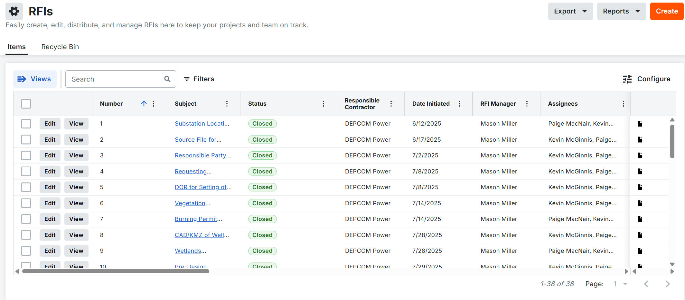
Stakeholder and Communications Management
RFI’s, Transmittals, Notices, and Submittals will be managed through Procore.
Workflows and distribution lists will be created for each instance to ensure the proper approvals are obtained as well as visibility to the correct audiences.
DEPCOM to support Evergy's Procore training as needed

Slide 22
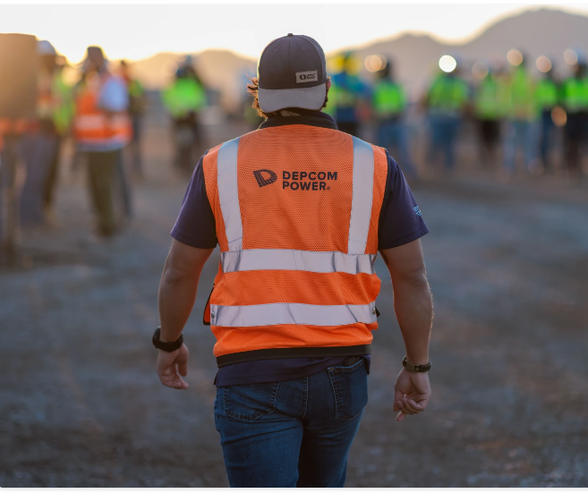
DEPCOM Quality Vision
The Quality Capability will support DEPCOM's operations, Pre-construction through close-out, Operations and Maintenance, and Services, by partnering with all areas of the business and clients to promote virtuous cycles of mutual benefit.
We will monitor and document the quality of our projects through a risk-based inspection test plan (ITP), identify deviations from standards, and ensure corrective actions are taken in a timely manner. We will develop and utilize a robust QMS program to capture learnings and drive transformation throughout the organization with focus on Supplier Quality and Self-Perform.
This will result in improved estimates, enhanced execution, and simpler close-outs of future projects resulting in satisfied clients.
Notes:
1. Our Quality Vision
DEPCOM’s Quality Capability supports every phase of your project—from pre-construction through close-out, including operations and maintenance.
We partner with clients across all business areas to promote virtuous cycles of mutual benefit.
Safety, Quality, Production (Work safe, focus on Quality, speed will come with repetition)
Stay close to the work and verify early to prevent rework. (trust but verify)
Quality is everyone’s job. The role of the QM is to make it clear and repeatable.
Coach and empower crews, not just inspectors.

Slide 23
Quality Assurance and Control Management
Overview
1 Site Quality Manager Responsibilities:
Monitor and document project quality using a risk-based Inspection Test Plan (ITP).
Identify deviations from standards and ensure prompt corrective actions.
2 Quality Manual:
A project-specific Quality Manual will be developed before the project’s Construction Start Date (CSD).
Reference: The Sunflower Sky Quality Manual is available in the Procore document folder.
3 Inspection and Test Plan (ITP):
The ITP is accessible in Procore through workflows and site-specific inspections, created prior to FAI inspection for each scope.
General ITP: Inspection flows are detailed in the attached document within Procore.
4 Subcontractor Meetings & Expectations:
The Site Quality Manager will conduct weekly meetings with the subcontractor’s Quality Representative.
Meetings focus on aligning inspection schedules and discussing items of concern.
Notes:
2. Proactive (not reactive) Quality Management
We use a risk-based Inspection Test Plan (ITP) to monitor and document project quality.
Tie quality checkpoints to schedule milestones to keep progress smooth.
Deviations from standards are swiftly identified; corrective actions are taken in a timely manner.
Our robust Quality Management System (QMS) captures lessons learned and drives ongoing transformation, with a focus on Supplier Quality and Self-Perform.
3. Continuous Improvement
Improved estimates, enhanced execution, and streamlined project close-outs for our clients are the direct results of our quality processes.
We are committed to delivering satisfied clients and successful outcomes.
4. Structured Quality Assurance & Control
A dedicated Site Quality Manager oversees project quality, using tailored inspection plans and documentation.
A project-specific Quality Manual is prepared before construction begins, ensuring clear standards and expectations.
We conduct weekly meetings with subcontractors to align inspection schedules and address concerns proactively.

Slide 24
Quality Assurance
5 First Article Inspections (FAIs):
FAIs are performed to verify that installation processes consistently produce products meeting specified requirements, as fully aligned upon the initial installation article by Evergy, DEPCOM, and Subcontractor
6 Inspections:
Work is inspected during installation and after completion of each area.
Inspection frequency: Starts with a higher percentage and is reduced if consistent quality is demonstrated.
7 Observations:
Observations are documented for issues found in the field or checklist failures.
Subcontractors have three business days to address observations.
Unresolved issues within this period are escalated to a Non-Conformance Report (NCR).
8 NCRs:
NCRs are issued for:
  Processes not properly followed
  Repeat or unresolved observations
  Major non-conforming items impacting the project
Notes:
. Inspection & Accountability
First Article Inspections (FAIs): Verify processes produce consistent, compliant results.
Regular Inspections: Work is inspected during installation and after completion. Frequency adapts to demonstrated quality.
Issue Resolution: Field observations are documented; subcontractors have three business days to resolve issues.
Escalation Path: Unresolved or major issues result in Non-Conformance Reports (NCRs), ensuring all concerns are addressed before project completion.
6. Koch Engineered Solutions Difference
As part of Koch Engineered Solutions, DEPCOM leverages industry-leading practices and resources to deliver value and reliability.
Quick Reference Table
Key Quality Measures-Client Benefit
Risk-based Inspections-Early issue detection
Timely Corrective Actions-Reduced rework, project speed
Weekly Subcontractor Meetings-Transparent communication
Three-Day Issue Resolution-Fast response to concerns
Non-Conformance Reports-Accountability and closure
Robust QMS-Continuous improvement

Slide 25

Logistics Management
DEPCOM Logistics team will coordinate with all deliveries to ensure:
  Correct Transportation Routes are followed per the contract.
  Deliveries are documented and uploaded into Procore.
Delivery locations:
  9 main laydown yards distributed across the entire project.
  All laydown yards are equipped with security fencing.
  Arrays will also be used to mitigate double handing.
Risks:
  Community Relations
  Unknown box culvert condition outside of permissible county roads.
Notes:
Recommended talking points from David Noriega
Site staging areas & storage conditions
Weather protection & security
Just-in-time vs. buffer stock
Aligning logistics with construction timelines
Coordinating multi-phase deliveries
Risk of delays & contingency strategies
Strong coordination between procurement & project execution
Last-mile delivery to remote/rural project sites

Slide 26
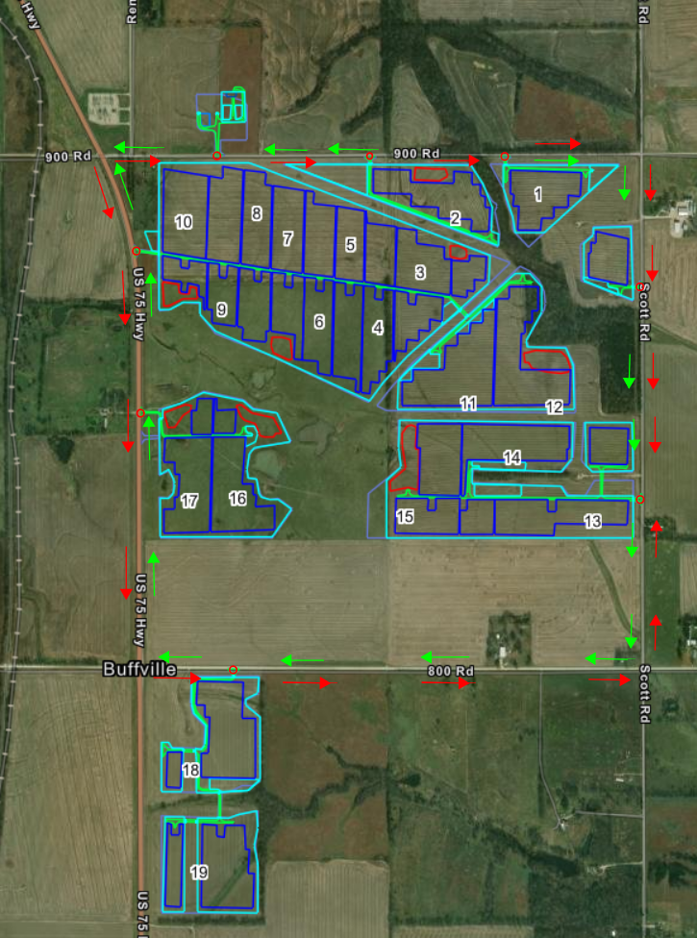
Logistics Management
Traffic Control Plan
LEGEND
Proposed Inbound Traffic.
Proposed Outbound Traffic.
Proposed Site entrance.
Project Boundaries.
Proposed route
All traffic will be directed to US-75.
US Hwy 75 at Buffville/ 800 Rd (Southwest corner) South entrance.
US Hwy 75 at 900 Rd (Northwest Corner) North Main entrance.

Slide 27

Construction Management
Highlights
  Block 1 MC – 2/12/27
  Block 2 MC – 2/19/27
  Block 3 MC – 2/26/27
  SC – 5/15/27
  FC – 10/22/27
Site Specific
  Contractor-specific Kick-Off Meetings – Prior to CSD for their activity
  Site Specific Safety Orientation
  Work Schedule M-F 7 am-5:30 pm
  Daily Morning Stretch and Flex / Safety Toolbox Talk - 7 am
  Daily POD (Plan of the Day) Meeting with all subcontractors – 7:30 am, notes to be sent out daily
Site Specific
  Weekly All Hands Safety Meeting – Wednesday at 7 am at the Main office laydown area
  Daily engagement of all site personnel to strengthen our Safety Culture and reinforce a safety-first mindset.
  Drive the schedule with coordination amongst all subcontractors
  Mitigate constraints at the site level, escalate as necessary.

Slide 28
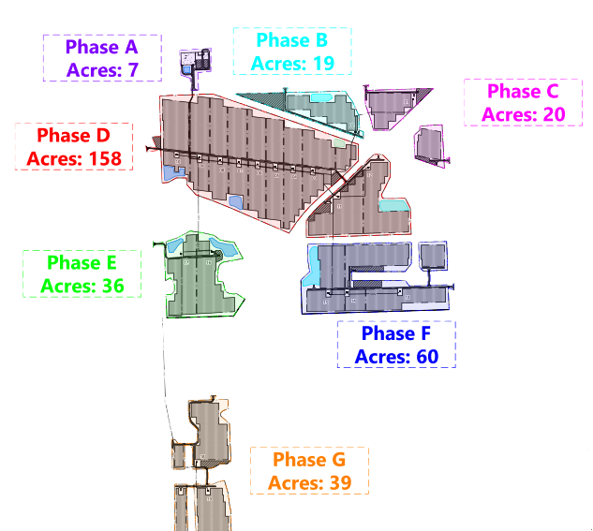
Construction Management
Phase G
Arrays 18 &19
Phase F
Arrays 13,14,15
Phase C
Array 1
Phase A
Substation & O&M Building
Phase B
Array 2
Phase D
Arrays 3,4,5,6,7,8,9,10,11,12
Phase E
Arrays 16 & 17

Slide 29
EPC–Client Integration for Communication
Purpose: Ensure seamless data exchange, control coordination, and compliance between the EPC-built substation/plant systems and the client’s (or utility’s) network.
Key Integration Aspects
Data Mapping & Signal Lists:
Align all telemetry points (breaker status, alarms, metering, etc.) between EPC and client SCADA systems.
Communication Protocols:
Standardize using DNP3, Modbus TCP/IP, or IEC 61850 to ensure interoperability.
Network Architecture:
Establish secure fiber or Ethernet links between local RTUs/PLCs and the client’s control center.
Cybersecurity & Access Control:
Implement firewalls, VLANs, and role-based access to protect both EPC and client networks.
Testing & Commissioning:
Conduct point-to-point and end-to-end communication tests to verify data accuracy and command response.
Change Management:
Document all IP assignments, tag naming, and system configuration updates jointly with the client.

Slide 30
NERC Compliance Overview
Purpose:
Key Compliance Areas
Ensure the PV plant and substation meet North American Electric Reliability Corporation (NERC) standards for grid reliability, cybersecurity, and operational integrity.
PRC (Protection & Control):Verify relays, breakers, and control schemes meet protection coordination and testing standards.
CIP (Critical Infrastructure Protection):Secure all communication networks, SCADA systems, and control access points.
FAC (Facilities Design & Maintenance):Maintain proper equipment ratings, clearances, and grounding per approved design documents.
EOP (Emergency Operations):Ensure operational readiness for abnormal or emergency grid conditions.
MOD (Modeling & Data):Submit accurate system modeling and performance data to support grid planning and studies.

Slide 31

Environmental Compliance
KDHE General Permit
Eastern Spotted Skunk Habitat
Spill Prevention, Control and Countermeasure
EPCRA / Tier II Reporting
DEPCOM EHS Excellence
In addition to complying with applicable laws and regulations, achieve a level of
safety and environmental performance that provides superior protection and
value, placing the highest priority on risks that could cause the most serious
harm to people, the environment, or the business.

Slide 32
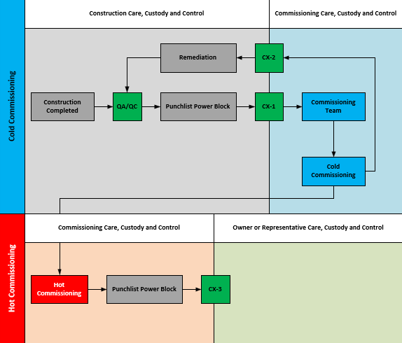
DEPCOM Commissioning Process
Clear Ownership of Care, Custody and Control.​
Enhanced safety, clearly defined responsibilities,and improved schedule management.
Discipline in Punchlist Management​
Data and Documentation Integrity​
"What "good looks like" is when documentationstands alone without needing verbal clarification"​
Collaborative Remediation and Communication.​
Defined End-State: Operation Readiness
Notes:
Reduce W/m2 standard

Slide 33
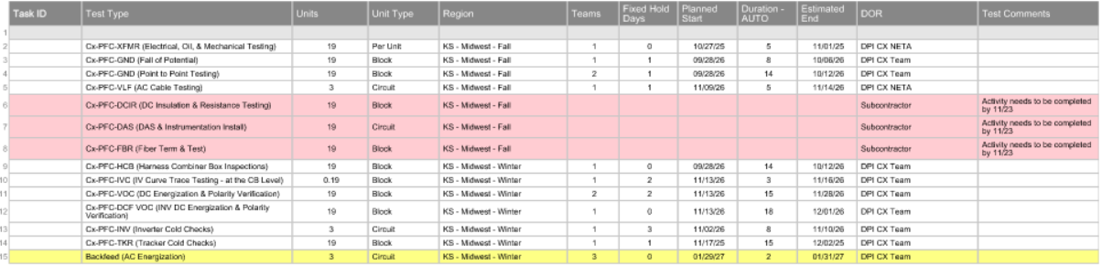
Commissioning Management
Performance Testing – CX teams will be engaged early to provide better visibility and scheduling for testing.
Multiple CX teams will be brought in as-needed
IV Curve Testing – There is a risk of reaching the W/m2 due to time of year and weather.
Notes:
Reduce W/m2 standard

Slide 34
Closeout Goals
Final Construction and Commissioning
  Complete Punchlist and verify resolution, Finalize testing and Commissioning
Site Cleanup & Restoration
  Occurs immediately post-commissioning
  Remove temporary structures, Dispose of construction debris, Restore site per contractual and environmental requirements
Equipment & Material Demobilization
  Concurrent with site cleanup
  Inventory all tools and equipment, Coordinate trailer and container removal, Transfer critical spares to O&M team.
Safety & Compliance Finalization
  Throughout demobilization
  Conduct final safety walkthroughs, Ensure compliance with AHJs, Archive safety documentation and training records
Documentation and Handover
  Compile and submit remaining as-builts, test reports, and turnover packages, Transfer care, custody, and control to operations team.

Slide 35
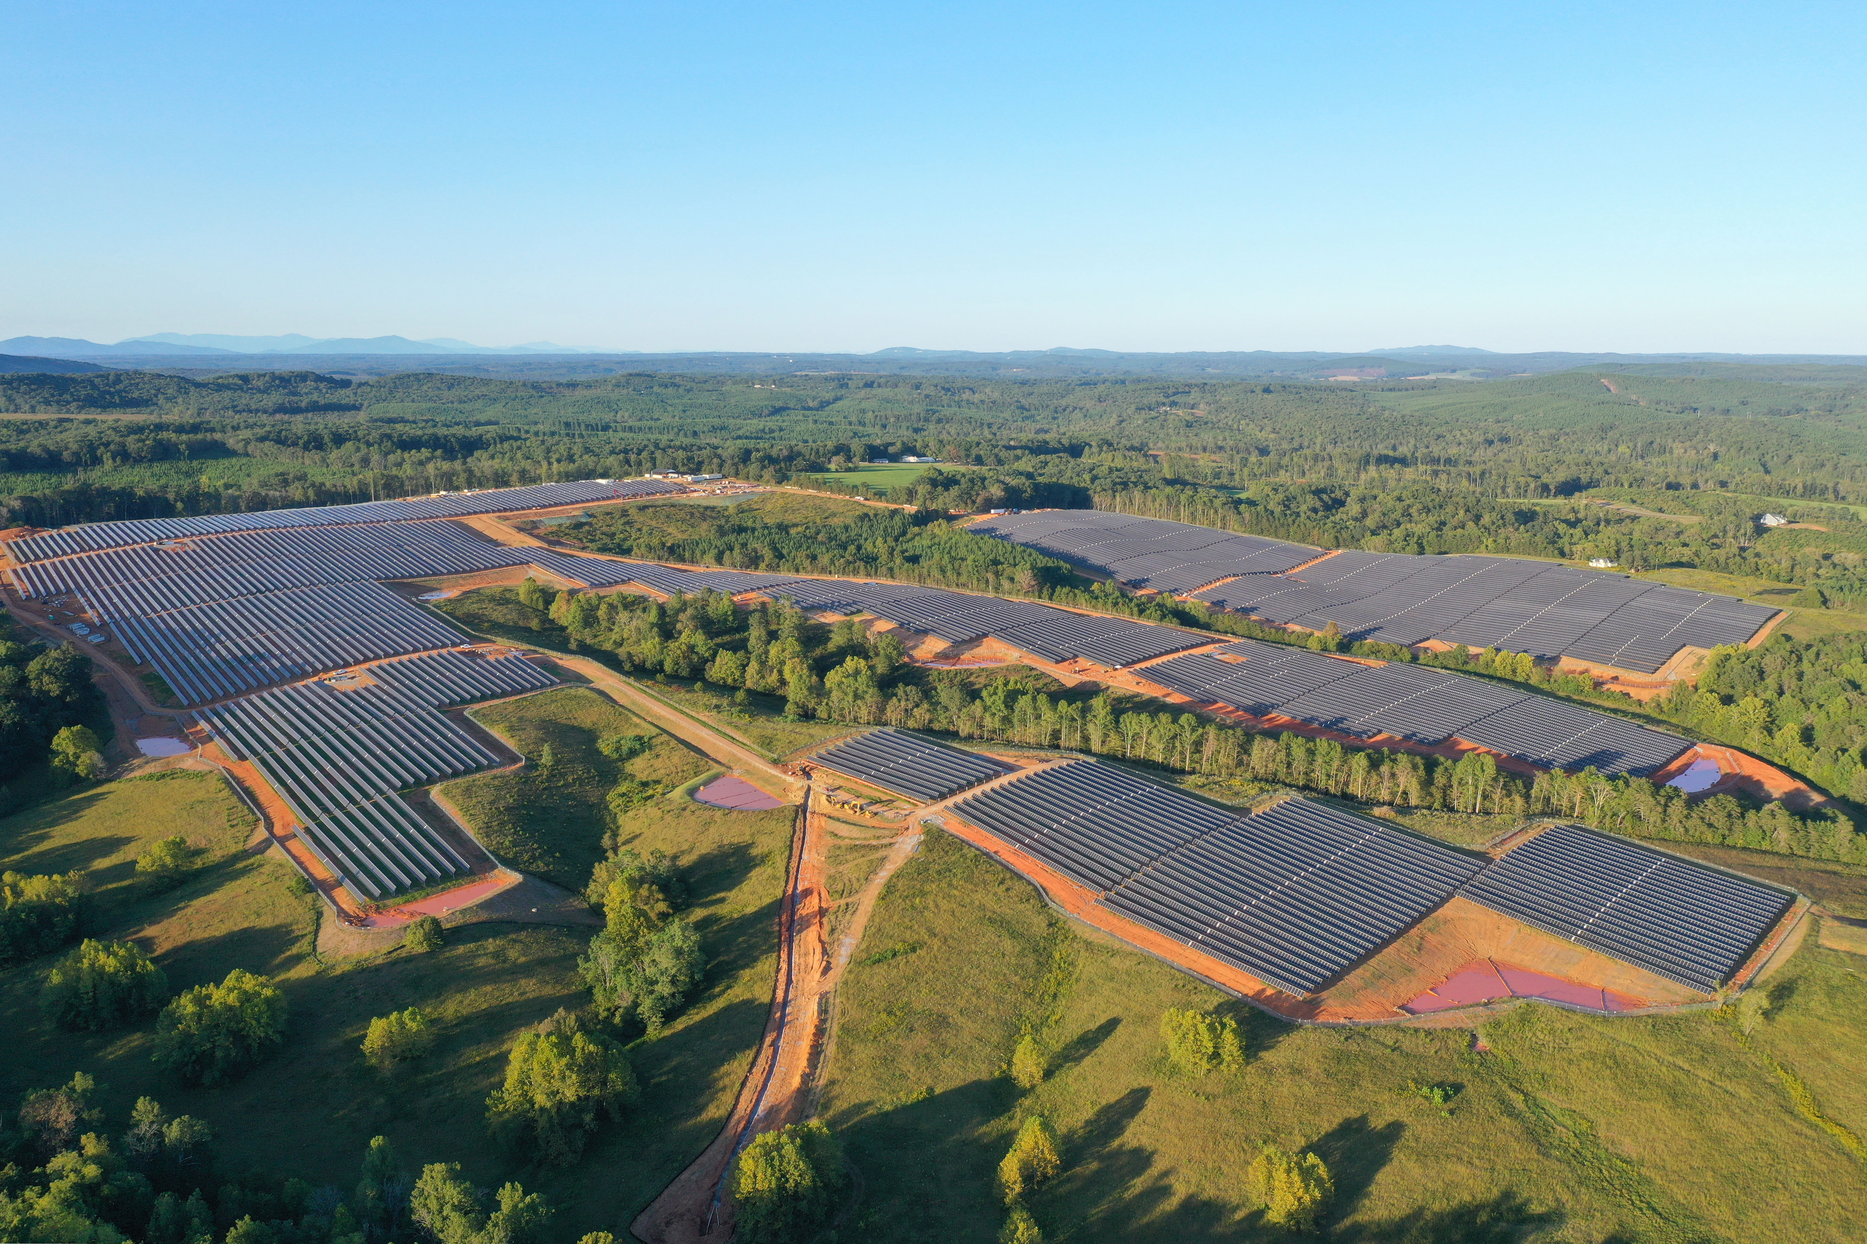
THANK YOU

Slide 36
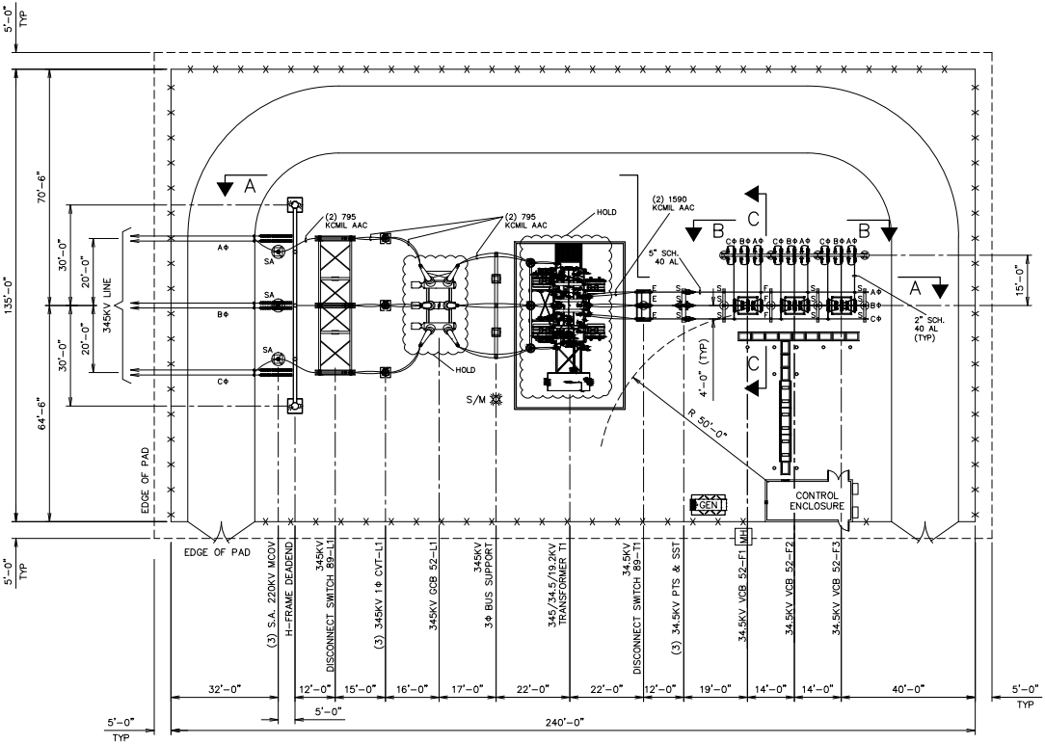
Substation
Project Snapshot
Location: LAT. = 40.952778, LONG –83.216137
Voltage: 345 – 34.5kV
Design Status: 30% Design Package
Critical Equipment on Order
EPC: Dashiell
Highlights / Risks
  Outage Coordination – Dependency on utility outage windows for cutovers/energization.
  Weather Impacts – Seasonal construction challenges (rain, snow, extreme heat, tornados).

Slide 37
Tymochtee Substation
Activity | Start | Finish
Design (Dashiell)
60% Design Package | 7/24/25 | 9/11/25
90% Design Package | 9/26/25 | 11/6/25
IFC Package | 11/20/25 | 12/18/25
Major Equipment Deliveries
SSVT (Dashiell) | 6/29/26 | 7/3/26
DCIM (Dashiell) | 5/2/26 | 5/2/26
Disconnect Switches (Dashiell) | 6/15/26 | 6/19/26
DE Steel (Dashiell) | 7/13/26 | 7/21/26
Transformer (Total) | 5/18/26 | 5/18/26
Breakers from Storage (Total) | 5/13/26 | 5/19/26
Construction (Dashiell)
Substation Mobilization | 3/3/26 | 3/6/26
Pad Grading | 11/3/26 | 12/12/26
Below Grade (i.e. Foundation, Ground Grid, Conduit) | 3/9/26 | 4/27/26
Above Grade (i.e. Steel, Breakers, Switches, DCIM, Bus) | 4/24/26 | 9/2/26
Pull and Term Cable | 7/13/26 | 8/31/26
Final Grading and Surfacing | 9/14/26 | 10/2/25
Testing Commissioning | 7/9/26 | 9/2/26

Slide 38
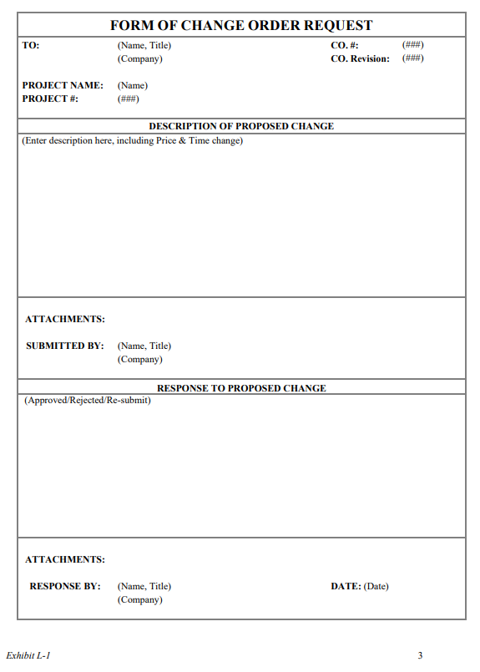
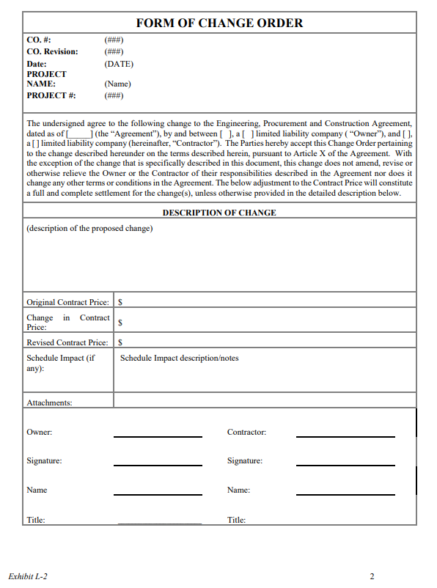
Change Management Process
PM to PM Notification
  Phone Call
  Email follow-up prior to submission
Two Step Process
  L1: Request for Approval
  L2: Approval Form
L1 – Change Order Requested
  COR includes cost estimates, schedule impacts, descriptions
  Approved
  Disapproved
  Provide more documentation
L2 – Formal Approval filled in by TE
Owner Change Order Log integrated in weekly and monthly discussions
Notes:
Add L1 and L2. Remove tracker

Slide 39
Procurement Schedule
Procurement​ | % Complete​ | Supplier | % Complete​ | Responsible Party​ | Delivery Start​ | Notes​
Inverters​ | 100%​ | Sungrow | PHB: 100%​ PHC: 100%​ | DEPCOM​ | 9/10/25 – 9/11/25​ | Norway Inverter deliveries will begin on 9/10/25.​ ​
Posts​ | 100%​ | Powerhouse | 100%​ | DEPCOM​ | 5/07/24 - 9/16/24​ | Start improved from 6/03/24 to 5/07/24.​ All posts delivered as of 9/16/24.​ Began staging posts in Portugal 10/17/24.​
Racking​​ | 100%​ | Nextracker | 100%​ | DEPCOM​ | 6/03/24 - 9/16/24​ | All racking delivered as of 9/16/24.​ Began staging racking in Portugal on 10/18/24.​
MV Cable​​ | 100%​ | Southwire/WTEC | 100%​ | DEPCOM​ | 7/24/23 - 9/23//24​ | ​
Fiber​ | 100%​ | TBD | 100%​ | DEPCOM​ | 7/24/23 - 9/23//24​ | ​
Ground Cable​ | 100%​ | TBD | 100%​ | DEPCOM​ | 7/24/23 - 3/1//24​ | ​
DC Cable​ | 100%​ | TBD | 100%​ | DEPCOM​ | 6/12/23 - 9/23/24​ | ​
Modules​​ | 100%​ | ZNShine | PHB: 100%​ PHC: 75% ​ | CLE​ | PHB: 7/31/24 - 12/06/24​ PHC: 8/25/25 – 9/30/25 ​ | On 8/12 DPI requested Phase C modules to be delivered starting 8/25 at a frequency of 6 loads/day. ​ ​
GSU​ | 100%​ | GSU Delivery/Setting​ | 100%​ | CLE​ | 12/8/23- 4/11/24​ | Furnished by Owner​
SCADA (PV)​ | 100%​ | SCADA​ | 100%​ | DEPCOM​ | 12/16/23-12/17/24​ | ​

Slide 40
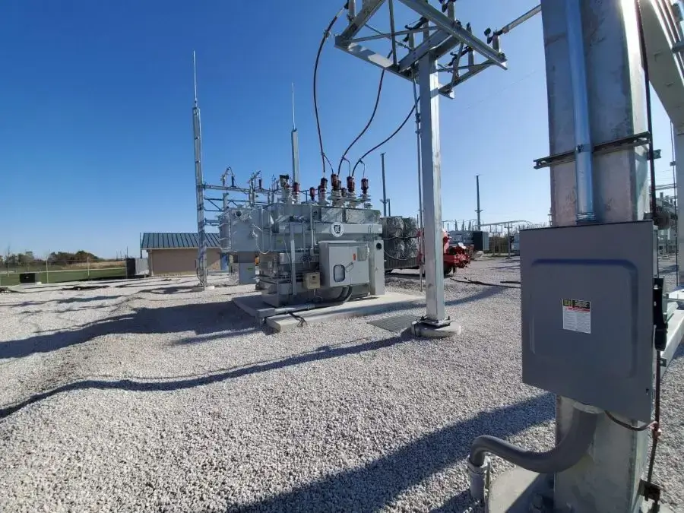
HV Support
The substation is the core connection point of the PV plant — linking power generation, high-voltage infrastructure, and control systems into one coordinated network.
PV Integration:
Inverters deliver medium-voltage AC power to the substation, where it’s aggregated and prepared for grid export.
HV Infrastructure:
Step-up transformers, breakers, and buswork raise voltage to transmission level and ensure protection, reliability, and grid compliance.
SCADA System:
Provides real-time monitoring, remote control, and data communication between the PV field, substation, and utility control center.

Slide 41
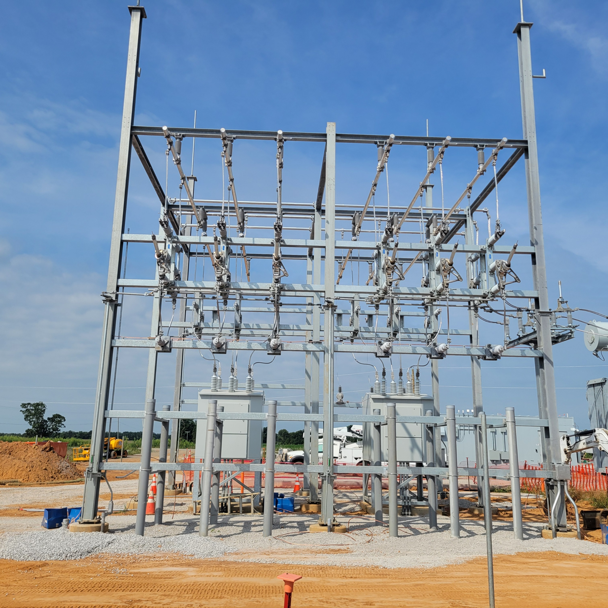
Substation Construction
Main Power Transformer (GSU): Steps medium-voltage (e.g., 34.5 kV) up to transmission level.
Circuit Breakers & Disconnect Switches: Provide isolation and protection for maintenance and faults.
Grounding System: Ensures personnel safety and equipment protection during faults.
Control House / Relay Panels: Houses protection relays, metering, and SCADA interface hardware.
Auxiliary Power & Lighting: Supports controls, communications, and maintenance functions.

Slide 42
Project Risks & Opportunities
Landowner Access
  Parcel x
Pile Driving Methodology
Gas Line Crossings
Vegetation / Stabilization
Trench SC34 to SC33
Fence Isolation Panel Alternate (gap)

Slide 43
Scope of Work & Major Equipment
DEPCOM: EPC 65 MW AC (88 MW DC) PV solar facility, substation and O&M Building
Evergy: Provide Substation GSU Transformer, Substation High-Side Main Breaker, ZNShine Modules (715W)
Major Equipment | OFE | Suppliers
Modules | X | ZNShine
Racking |  | Nextracker
Piles |  | TBD
PCS |  | Sungrow​
Substation Service Transformer |  | TBD
Control Enclosure |  | Modular Connections
HV Breakers | X | Siemens
Disconnect Switches |  | TBD
DE Steel |  | TBD
GSU Transformer | X | Prolec GE

